Slide 1
2023
NAFB LISTENERSHIP

Slide 2
OBJECTIVES
1
Examine the habits and practices of those who
consume ag radio programming
2
Inform future strategies for sales and programming
STUDY
SUMMARY
357 phone interviews during Summer 2023
Nationwide sample of decision-makers on operations of $100K+ GFI
Regularly consume ag radio content
CONFIDENTIAL 2

Slide 3
CONTENT & CONSUMPTION

Slide 4
Daily Sources of Ag News
Ag/farm radio 63%
Ag/farm television 34%
Ag/farm publications 31%
Blogs/websites/news sources that I seek out 17%
Online farm forums 15%
E-newsletters I receive from suppliers 15%
Social media 14%
Ag/farm related apps for smartphone/tablets 13%
Text notifications from suppliers, manufacturers 13%
E-newsletters I receive from publications 13%
Company or industry websites 12%
Ag/farm shows 10%
Farm radio websites 9%
Ag/farm podcasts 8%
Ag radio is the leading daily source of farm news
Listeners tune into ag radio for timely information every day. The type of content ag radio provides (weather, markets and news) lends itself to daily consumption.
Source: Total 2023 respondents (n=357). 2023 Aimpoint NAFB Listenership Study, Aimpoint Research
CONFIDENTIAL 4
CONFIDENTIAL

Slide 5
Ag broadcast radio is the number one source for farm news among listeners.
Sources of Farm News
Broadcast radio 89%
Ag/farm publications 75%
Ag related websites 60%
Television 57%
Social media 42%
YouTube 31%
Online forums 29%
Podcasts 27%
Satellite radio 22%
Online radio _{21%}
Streaming services 21%
Those who regularly listen to ag radio content are also engaged in other media channels to keep up to date with farm news, weather, markets, and ag info.
On average, respondents utilize several informational sources.
Source: Total 2023 respondents (n=357) 2023 Aimpoint NAFB Listenership Study, Aimpoint Research
NOTE: Some shares adjusted to align with subsequent responses later in the survey.
CONFIDENTIAL 5

Slide 6
Q UAL I NSI G HTS
“
Media & Information Sources
Listeners rely on a wide range of sources - news, radio, podcasts, social media, and connecting with peers.
They are always trying to gather information to make them better at all the various aspects of their job.
… I don't go anywhere without turning my radio on in my truck…And I still listen a lot to that local radio station to get the weather, the news, and their spin on it.
– Farmer Listener from Illinois
Information Sources
There is a wide range of ag information that they rely on, including radio broadcasts, farm magazines, podcasts, YouTube videos, newsletters, and specific online platforms.
They leverage these sources to stay informed and gain knowledge about farming practices.
Source: 2023 Aimpoint NAFB Listenership Study, Aimpoint Research
CONFIDENTIAL 6

Slide 7
Listeners look to ag radio for info that directly impacts their operations.
While listeners rely on ag radio for info on a variety of topics, market info and commodity pricing, as well as weather are the two most pertinent topics for ag radio listeners.
Info Desired from Ag Radio
Ag markets/Commodity prices
89%
Ag weather
74%
Local/Regional Ag news
40%
Farm commentary
31%
These are the two most relevant areas of ag radio content regardless of age, GFI, or operation size.
World Ag/Trade News
30%
Insights from Washington DC/Policy updates
28%
New Products; seed, equipment, technology
27%
Agriculture innovation 23%
Source: Total 2023 respondents (n=357) 2023 Aimpoint NAFB Listenership Study, Aimpoint Research
CONFIDENTIAL 7

Slide 8
Next Generation Farmers Listen to Radio
NEXT-GEN AND CURRENT-GEN FARMERS
LISTEN TO THE RADIO EQUALLY THROUGHOUT THE DAY
73 MINUTES DAILY
73 MINUTES DAILY
Age 49 & under
Age 50+
Source: 2019 Millennium Farm Radio Listening Waves 1-4

Slide 9
Ag Radio is #1 Weekly Platform for Larger Growers
In fact,
32.9%
92.5%
of 500+ acre farmers
listen to their favorite local radio stations each week
of 500+ acre farmers
listen to radio
at any given time
during the day, Monday-Friday 5 a.m.- 7 p.m.
Source: 2020 AMR Ratings Study

Slide 10
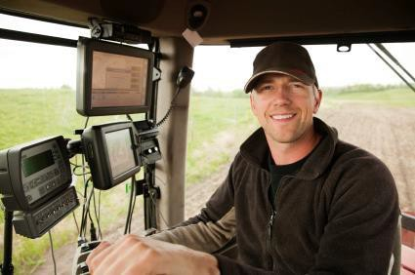
Large Operation Farmers Listen to Radio
More than 91% of 100K+ GFI farmers listen to AM/FM radio each week and 92% with 500+ acres
Large Acre Farmers are Heavy Radio Listeners M-F 5A-7P
On average one out of every three listen to radio at any given time during the week
100
92.8
90.0 92.7 92.5 91.8
90
80
70
60
50
40 32.1
32.6
33.0
32.9
31.3
30
20
10
0
WHEAT PRODUCERS
250+ ACRE CORN
250+ ACRE SOYBEANS
500+ PLANTED ACRES
$100,000+ GFI
% LISTENING AT ANY TIME*
% LISTENING EACH WEEK*
Source: 2022 AMR Radio Ratings, M-F 5a-7p, IA-IL-IN-KS-MI-MN-MO-NE-OH-ND-SD-WI

Slide 11
Q UAL I NSI G HTS
“
Trust
They deem it important to have trust in the information they receive and indicate they have confidence in farm broadcasters as trusted sources of information who provide accurate and unbiased news.
There is an appreciation for farm broadcasters' role in sharing market updates and global events.
(Farm) Broadcasters are trusted friends. I truly believe that they want to tell you the true story. The right story. Without any bias.
– Farmer from South Dakota
Source: 2023 Aimpoint NAFB Listenership Study, Aimpoint Research
CONFIDENTIAL 11

Slide 12
Farmers Trust Ag Broadcasters
Farm broadcasters dramatically outperform national news media (NBC, CBS, etc.) in the areas of credibility, accuracy, and timeliness
(Farm) Broadcasters are trusted friends. I truly believe that they want to tell you the true story. The right story. Without any bias. - Farmer from South Dakota
Ag Broadcaster Credibility
Perceptions of Media*
78%
72%
73%
70%
National news
Farm broadcaster
70%
66%
64%
16%
Credible
18%
76%
Accurate Information
28%
68%
Are credible
Provides accurate information
18-54 55+
Provides timely information
Timely
Information
Source: 2023 Aimpoint NAFB Listenership Study

Slide 13
ADVERTISING EFFECTIVENESS

Slide 14
Ag Radio Drives Listeners Online
Research shows,
58%
of farm radio listeners have visited a website after hearing advertiser messages on radio
And, it’s even higher for farmers 18-54,
71%
visited websites after hearing messages on radio
Source: 2023 Aimpoint NAFB Listenership Study

Slide 15
Those who visited a website after hearing about it on the radio are more likely to access digital, non-digital news sources.
Daily ag news sources
Ag/farm radio
62%
66%
Ag/farm publications
28%
34%
Blogs/websites
19%
13%
Social media
17%
9%
Online forums
20%
9%
Visited website
Did not visit website
Source: Visited website (n=206); Did not visit website (n=151) 2023 Aimpoint NAFB Listenership Study, Aimpoint Research
CONFIDENTIAL 15

Slide 16
LISTENING HABITS

Slide 17
Traditional AM/FM radios have extensive reach throughout farming operations
The average listeners’ farm contains nearly
11 radios with more than half having 20+
Because AM/FM radios are a standard feature of on-farm infrastructure, ag programming can easily and conveniently reach listeners at various times and locations.
Where Listen to Ag Radio
While driving farm pickup/ SUV/passenger vehicle
AM/FM radio broadcasts are prevalent throughout farms. Farmers listen to broadcast ag radio in a variety of locations and situations. This is made possible by the large number of radios that can be found throughout farming operations.
73%
While operating farm equipment
64%
In the house
37%
Types of Radio Use for Farm News
In the shop
34%
While trucking grain or livestock
34%
89%
In the office
32%
While doing chores
25%
27%
22%
In the barn
18%
AM/FM radio
Streaming radio
Satellite radio
Source: Total 2023 respondents (n=357); Listen to AM/FM radio (N=317) 2023 Aimpoint NAFB Listenership Study, Aimpoint Research
CONFIDENTIAL 17
CONFIDENTIAL

Slide 18
Radio Rules the Farm
Where They Listen
Over half of listeners’ operations
boast 20+ radios.
While driving farm pickup/SUV/passenger vehicle
While operating farm equipment
73%
64%
In the house
37%
In the shop
34%
While trucking grain or livestock
34%
The average listener’s farm contains
nearly 11 radios.
In the office
32%
While doing chores
25%
In the barn
18%
Source: 2023 Aimpoint NAFB Listenership Study

Slide 19
Farmers Rely on Radio Throughout the Year
Ag radio gives immediate information that is easily accessible in a way no other medium can provide.
% Daily Ag Radio Listening
75%
60%
45%
30%
15%
0%
71% |  | 76% |  | 79% 79%
Q4 2020
Q1 2021
Q2 2021
Q3 2021
Source: 2021 Aimpoint NAFB Listenership Study

Slide 20
On-air ag radio is a major part of listeners’ weekday routine.
Those who listen to AM/FM radio for ag programming do so on most days with a large majority (83%) listening at least 5 days per week.
5+ Days a Week
83%
Source: Listen to AM/FM radio (n=317)
CONFIDENTIAL 20

Slide 21
Listeners start each morning by tuning into ag radio for the
day’s most important information.
Time of Day Listen to Ag Radio Programming
6-9 AM 9AM-noon Noon-4PM After 4PM
Listening to on-air ag radio is a key ingredient to farmers morning routine.
60%
44%
46%
41%
32%
This pattern holds for both AM/FM and streaming radio.
22%
24%
26%
Broadcast radio
Streaming radio
Source: Listen to AM/FM radio (n=317); Listen to streaming radio (n=95) 2023 Aimpoint NAFB Listenership Study, Aimpoint Research
CONFIDENTIAL 21

Slide 22
DIGITAL MEDIA CHANNELS

Slide 23
Listeners use digital
media channels to gather ag-based information.
Portion of Content Consumed that is Ag-related
All Ag-related Most Ag-related
Half or less Ag-related
15%
39%
32%
39%
YouTube
Podcasts
46%
30%
Source: Ever listened to ag podcast (n=186); Regularly watch ag-related YouTube programming (n=112) 2023 Aimpoint NAFB Listenership Study, Aimpoint Research
CONFIDENTIAL 23

Slide 24
Younger listeners are more engaged in digital media channels
than their seasoned counterparts.
18-44
45+
63%
62%
54%
44%
38%
38%
38%
28%
28%
25%
Use social media for ag info
Use TV for ag info
Listened to ag-related podcast in past month
Regularly watch ag-related YouTube content
Listen to streaming radio
Source: 18-44 (n=52); 45+ (n=305) 2023 Aimpoint NAFB Listenership Study, Aimpoint Research
CONFIDENTIAL 24

Slide 25
Farm Radio Listeners’ Digital Media Usage
18-44 45+
63%
62%
44%
38%
38%
38%
28%
25%
Use social media for ag info
Use TV for ag info
Listened to ag-related podcast in past month
Listen to streaming radio
Source: 2023 Aimpoint NAFB Listenership Study

Slide 26
Podcast Listenership
Urban dwellers exhibit a stronger inclination towards podcasts, spending 13% of their daily audio time on this format – more than double the percentage seen among rural listeners, who allocate just 6% of their time to podcasts.
Podcasts Listenership
13%
11%
6%
Urban
Suburban
Rural
Source: 2023 Edison Research, Share of Ear Q4

Slide 27
KEY FINDINGS & RECOMMENDATIONS

Slide 28
KEY TAKEAWAYS
1 Ag radio is a trusted resource for commodity prices and weather.
Among listeners, tuning into ag radio in the morning is a key part of
their daily routine.
Broadcast ag radio’s widespread physical presence on farming
operations gives it a competitive advantage in terms of reach.
Digital online media consumption of ag-content through YouTube, podcasts, and streaming radio is more prevalent among younger farmers.
Ag radio drives engagement with websites mentioned on the air. This is especially the case for listeners who are more digitally engaged and younger.
2
3
4
5

Slide 29
RECOMMENDATIONS
Continue to focus on key content of News, markets, and weather
Focus ad sales message on broadcast radio’s unique physical
reach and the routine nature of its listenership.
Be mindful that younger listeners are more digitally engaged than
their older counterparts.
1
2
3

Slide 30
“
Sometimes guys like me are working alone in the shop or you're in the tractor wondering if you're the only one having the problems or facing the challenges you're facing. Then you tune in to ag media (radio) and you hear other people like you talking about having the same problems and it gives me comfort knowing I'm not alone. And they have advice and information that helps me. Maybe I'm thinking about biologicals and whether I should try them, I can go look up recent podcasts or broadcasts or articles and that gives me a start.
CONFIDENTIAL 30

Slide 31
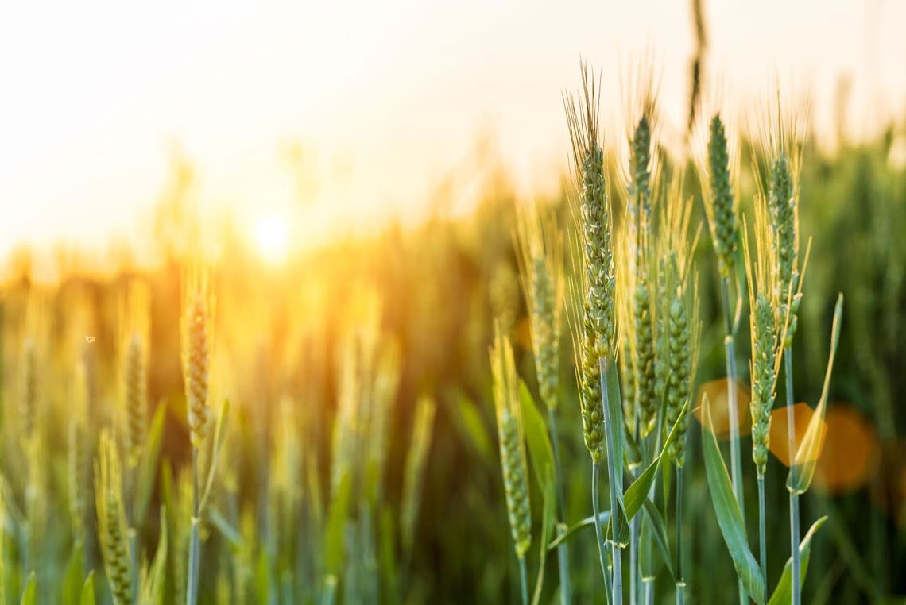
CURRENT ENVIRONMENT

Slide 32
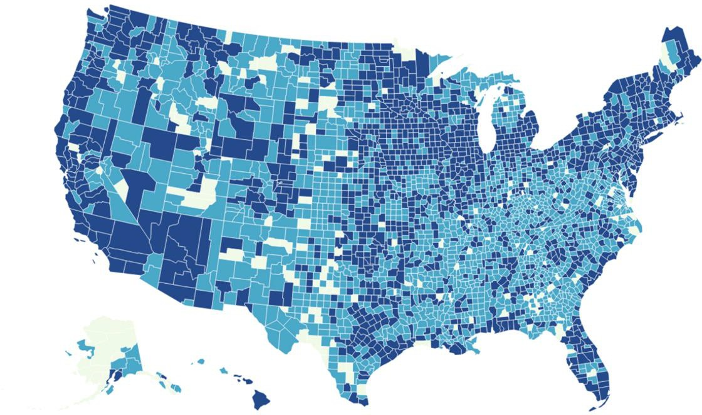
Newspapers Vanishing
Rural areas are the most affected.
Urban and suburban areas have digital news replacing traditional newspapers – this is less common in rural areas.
The US is losing 2 newspapers per week
Since 2005, over a quarter of newspapers that have been permanently shut down were in mostly rural counties.
1/3
The U.S. is on track to lose one-third of its newspapers by 2025.
Source: 2023 Aimpoint NAFB Listenership Study and Northwestern University-Medill School of Journalism, Media and
Integrated Marketing Communications

Slide 33
ADDITIONAL DATA

Slide 34
Unlike broadcast radio, satellite radio listenership is limited to passenger vehicles.
Where Listen to Satellite Radio Most Often
Satellite receiver _{75%} in truck or car
Listen through telephone app to ear buds, headphones, or 10% Bluetooth speaker
Satellite receiver _{6%} in ag equipment
Stationary speaker in home or shop that accesses ^{6%} satellite service via wifi
Via computer & _{3%} computer speakers
Presence of Radio Devices in Ag Equipment (combines, etc.)
81%
AM/FM Radios
22%
Satellite Radio
Source: Total 2023 respondents (n=357); Pay for satellite radio (n=108); Listen to AM/FM radio (n=317) 2023 Aimpoint NAFB Listenership Study, Aimpoint Research
CONFIDENTIAL 34

Slide 35
…and the content consumed on satellite radio is not predominantly ag focused.
While 30% of listeners
interviewed pay for a
satellite radio subscription,
only 22% use the service
Satellite Radio Purchase and Listenership
to gather ag-related news.
30%
Pay for Satellite
Radio Subscription
22%
Listen to Satellite
Radio for Ag News
This, along with satellite’s
limited on-farm presence,
suggests that satellite
radio is not a major
conveyer of ag news.
Source: Total 2023 respondents (n=357); Pay for satellite radio (n=108); Listen to AM/FM radio (n=317) 2023 Aimpoint NAFB Listenership Study,
Aimpoint Research
CONFIDENTIAL 35

Slide 36
AUDIENCE SAMPLE

Slide 37
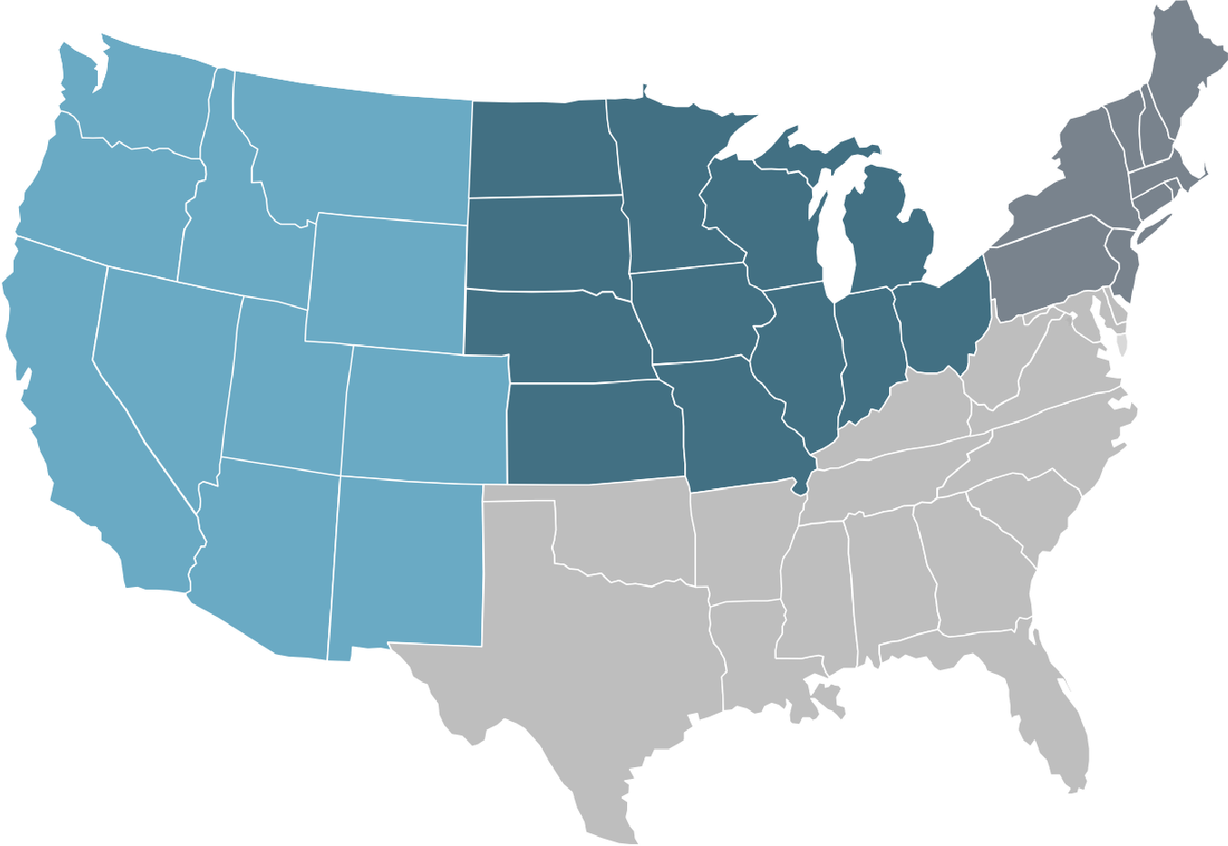
Listener Demo Profile
3%
Northeast
Gender
14%
Female
86%
Male
71%
Midwest
10%
West
16%
South
Source: Total 2023 respondents (n=357) 2023 Aimpoint NAFB Listenership Study, Aimpoint Research
CONFIDENTIAL 37

