Slide 1
2025 NAFB Listenership Research
Prepared for NAFB
March 2025

Slide 2
Objectives
Continue identifying media use and farm radio listening habits, with a specific focus on how ag radio performs in the media mix and outcomes.
Determine farm radio listening habits
Identify importance of radio & broadcasters
Measure perceptions of farm broadcasters
Determine use and habits of radio and other media types
Identify outcomes from farm radio listenership

Slide 3
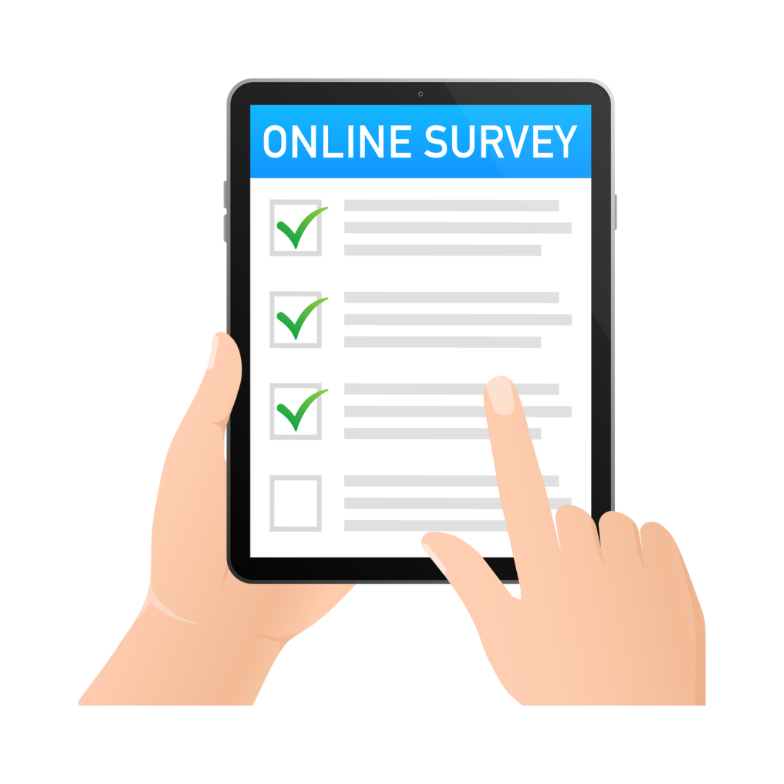
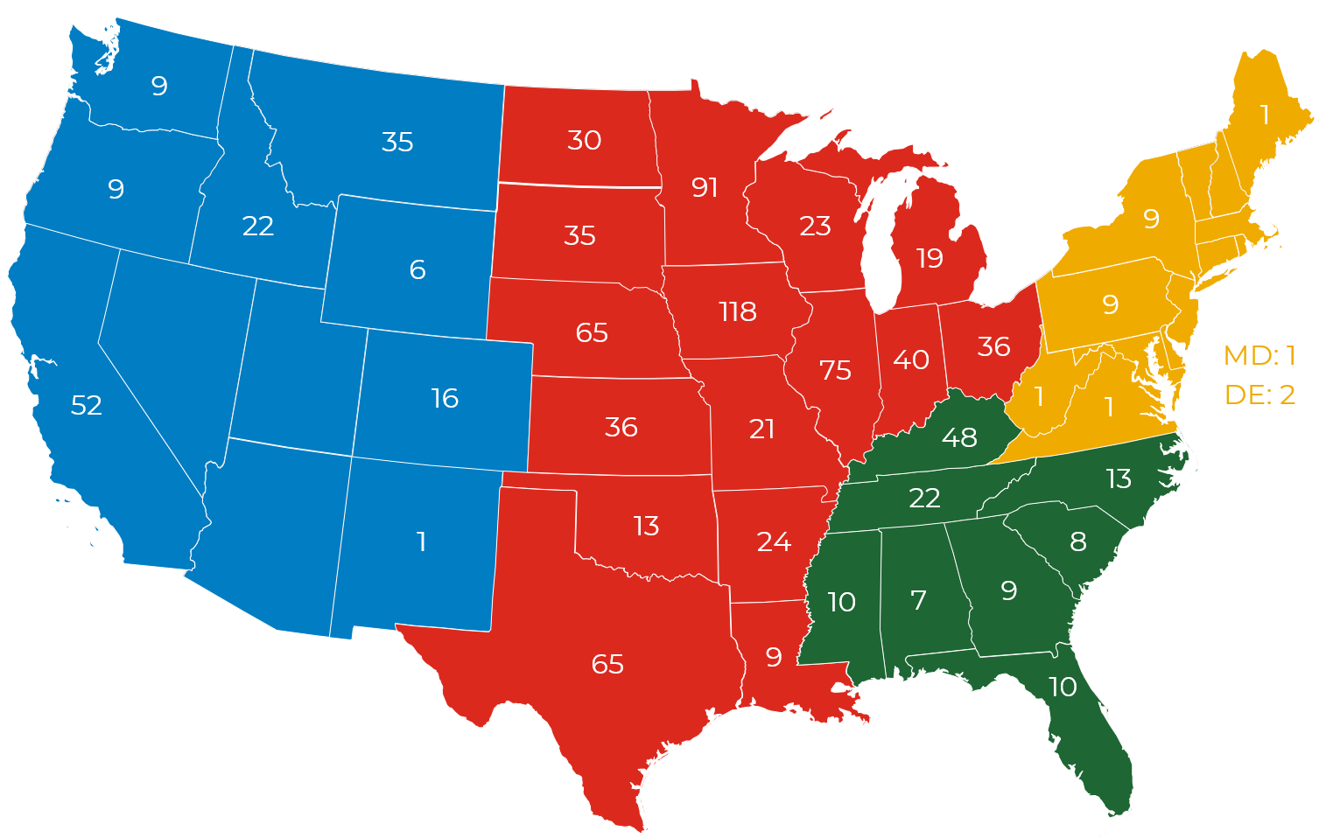
Target Audience
1
Geography
Nationwide based on percentage of state GFI
Methodology
1,001 online and phone surveys were conducted in January and February 2025.
(~90% online, ~10% phone)
6
65
Screening Requirements
To qualify:
Input in crop and equipment decisions
Produce crops, livestock, or both
Gross farm income of at least $250,000
Within 50-mile radius of station airing content produced by NAFB member
Listen to ag radio
52
16
36
1
13
65

Slide 4
Key Takeaways

Slide 5
Media Type Use Frequency
More than one-third of farmers who listen to the radio, listen more than once per day.
MORE THAN ONCE A DAY | ONCE A DAY | ONCE PER WEEK | EVERY OTHER WEEK | ONCE PER MONTH | LESS THAN ONCE PER MONTH | NEVER
Note: Respondents must have selected they listen to radio in the screening section to qualify.
Four respondents do not listen to broadcast radio but do listen to streamed radio
Base: (n=1,001)
Q1. How often do you use each of the following media types for farm news, weather, markets, and ag information?

Slide 6
Listening Locations
Most farmers listen to farm radio while driving a vehicle or operating farm equipment, which can be attributed to the accessibility of the platform.
While driving a vehicle (car, truck, etc.)
While operating farm equipment (spraying, planting, harvesting)
In the shop/office/barn
At home/In the house
While doing chores
Base: (n=1,001)
Q4. Where do you listen to farm news, weather, and commodity markets on the radio?

Slide 7
Farm Radio Days Listening
Weekdays are the most often selected days for listening to farm radio. However, more than one-third say they listen to farm radio on Saturday.
93%
of growers listen at least once a week
MON
TUE
WED
THU
FRI
SAT
SUN
Base: (n=1,001)
Q2. For farm radio, please tell us which days of the week you are listening.

Slide 8
Radio Information: Importance
Ag markets and ag weather are consistently selected as the most important information farmers gather from farm radio.
EXTREMELY IMPORTANT | IMPORTANT | MODERATELY IMPORTANT | SLIGHTLY IMPORTANT | NOT IMPORTANT AT ALL
Ag markets and commodity prices
Ag weather
Local/regional ag news
World ag/trade news
Farm broadcaster commentary
New ag products / Ag innovation
Base: (n=1,001)
Q6. How important is each of the types of information below while listening to radio?

Slide 9
Radio Information: Reasons to Gather through Radio
While top reasons farmers turn to radio vary, accessibility, availability, and convenience are mentioned as a top 3 reason for each information type.
AG MARKETS & COMMODITY PRICES | AG WEATHER | FARM COMMENTARY | LOCAL/REGIONAL AG NEWS | WORLD AG/TRADE NEWS | NEW AG PRODUCTS / AG INNOVATION
(n=806) | (n=819) | (n=454) | (n=581) | (n=577) | (n=373)
37% | 29% | 21% | 27% | 20% | 27%
Accessible, Available, Convenient | Weather specific to me, farm-focused | Important to stay informed, learn general information | Local information that is relevant to me | Accessible, Available, Convenient | Enjoy hearing about new products
21% | 25% | 18% | 26% | 19% | 21%
Important to know market info for my business decisions and know what is going on | Accessible, Available, Convenient | Accessible, Available, Convenient | Important to stay informed, learn general information | Important to stay informed, learn general information | Important to stay informed, learn general information
17% | 19% | 12% | 18% | 17% | 15%
Can listen while doing other things | Up-to-date, quickly get updated information | Interesting content, enjoy hearing the commentary | Accessible, Available, Convenient | Know what is going on in the nation and around the world, learn if it impacts me | Accessible, Available, Convenient
Base: Respondents selecting Important or Extremely Important in Q6. (Max per respondent); top 3 answers shown
Q6a. Why do you turn to radio for [insert types where Q6= important/extremely important]?

Slide 10
Most Trustworthy Source for Ag News: Top 5 Ranking
For farmers who listen to farm radio, nearly half believe that farm radio is the most trustworthy source for ag news, significantly more than for farm publications and other ag media sources.
1st CHOICE
2nd CHOICE
3rd CHOICE
4th CHOICE
5th CHOICE
TOTAL TOP 5 CHOICE
Base: (n=1,001)
Q7. Please select the media types you believe to be the most trustworthy sources for ag news and information.

Slide 11
Overall New Ag Product Awareness & Next Step
FARM RADIO RANKS AMONG THE TOP SOURCES IN MEDIA MIX WHEN LEARNING ABOUT NEW AG PRODUCTS
Base: (n=1,001)
Q8. Now, please think specifically new inputs or products you would purchase for your farming operation. How do you become aware of new products/services? Please select all that apply

Slide 12
New Ag Product Awareness & Next Step
AFTER YOU ARE AWARE, WHAT METHODS DO YOU USE TO LEARN MORE?
Base: (n=1,001)
Q9. After you hear about a new product, which methods do you use to learn more? Select all that apply

Slide 13
New Ag Product Awareness & Next Step (Radio Break-Out)
Selected in Q8: | Radio – Broadcast and/or Streamed (n=547)
Contact local retailers/suppliers/co-ops
Search on Google or web
Contact other growers/trusted peers
Contact agronomist/ consultant
Watch online videos (YouTube)
Contact product/ company rep
Visit consumer review sites
Engage with social media
AFTER YOU HEAR ABOUT A NEW PRODUCT (ON RADIO), WHICH METHODS DO YOU USE TO LEARN MORE?
Base: (n=1,001)
Q8. Now, please think specifically new inputs or products you would purchase for your farming operation. How do you become aware of new products/services? Please select all that apply
Q9. After you hear about a new product, which methods do you use to learn more? Select all that apply

Slide 14
Actions after Hearing Ad
After hearing a radio ad, farmers most often visit the website mentioned in the ad or search online for the product or company mentioned. Purchase most likely to occur when they contact their retailer as follow-up.
 | % SELECTED (n=1,598) | MADE PURCHASE
Visit website mentioned in ad
Online search for product/company
Contact my retailer/co-op
Make a note to look into product/ company later
Contact my consultant/ agronomist
Contact other grower
Contact product/company rep
Search on social media
Call phone number mentioned in ad
(n=477)
(n=488)
(n=466)
YES, HAVE PURCHASED OR INTEND TO PURCHASE
NO, HAVE NOT PURCHASED
(n=407)
(n=370)
(n=372)
(n=269)
(n=188)
(n=175)
Q13. In the past six months, when you’ve noticed a [ad type], what action do you typically take?
Q14. For the [ad type], where you [Insert Q13 response], did you end up purchasing the product or using the company you heard an advertisement for? Or do you intend to purchase the product or use the company?

Slide 15
Farm Broadcaster Impact
WHEN YOU HEAR A FARM BROADCASTER MENTION A PRODUCT OR COMPANY,
HOW MUCH IMPACT DOES THE BROADCASTER HAVE ON YOUR PERCEPTION OF THAT PRODUCT OR COMPANY?
STRONG to MODERATE IMPACT
NOT MUCH IMPACT
NONE AT ALL
Base: All Respondents (n=1,001
Q15. When you hear a farm broadcaster mention or discuss a product or company, how much impact does the broadcaster have on your perception of that product or company?
Q16. What is your perception of the trustworthiness, engagement, and impact of farm radio broadcasters compared to other ag influencers?

Slide 16
Farm Broadcaster Impact
WHO IS MORE TRUSTWORTHY, ENGAGING AND IMPACTFUL?
FARM RADIO BROADCASTERS
AG INFLUENCERS
46%
NEUTRAL
13%
Base: All Respondents (n=1,001)
Q16. What is your perception of the trustworthiness, engagement, and impact of farm radio broadcasters compared to other ag influencers?

Slide 17
Summary: Key Takeaways
LISTENING HABITS
TRUSTWORTHY
SOCIAL MEDIA
FREQUENCY: Radio is the most frequently visited ag medium.
MOBILITY: Typically, farmers listen while driving a vehicle or operating farm equipment.
CONNECTED: Nearly 2/3 listening to radio also using Facebook (65%).
PURCHASE: Those that turn to social media after hearing an ad on radio are likely to have either purchased or intend to purchase the product in the ad (75%).
MOST TRUSTWORTHY: 42% of farmers select farm radio as their 1st choice source for trustworthy ag news and information.
INCREASED PERCEPTION: 59% of farmers say that hearing a farm broadcaster mention a product or company has an impact on their perception of the product/company
ULTIMATE INFLUENCERS: Significantly more (46%) farmers say farm radio broadcasters are more trustworthy, engaging, and impactful compared to ag influencers (13%).
BRAND AWARENESS
INFORMATION
TOP SOURCE: Half of listeners hear about new products via radio. These farmers then typically turn to their local retailer or research online.
PURCHASE: Those who turn to their retailer after hearing a farm radio ad either purchase or intend to purchase (80%)
TOP DESTINATION: Ag markets and local weather are the most important information farmers turn to ag radio for.
TOP REASONS: Easy, convenient, quick, localized, accurate info.

Slide 18
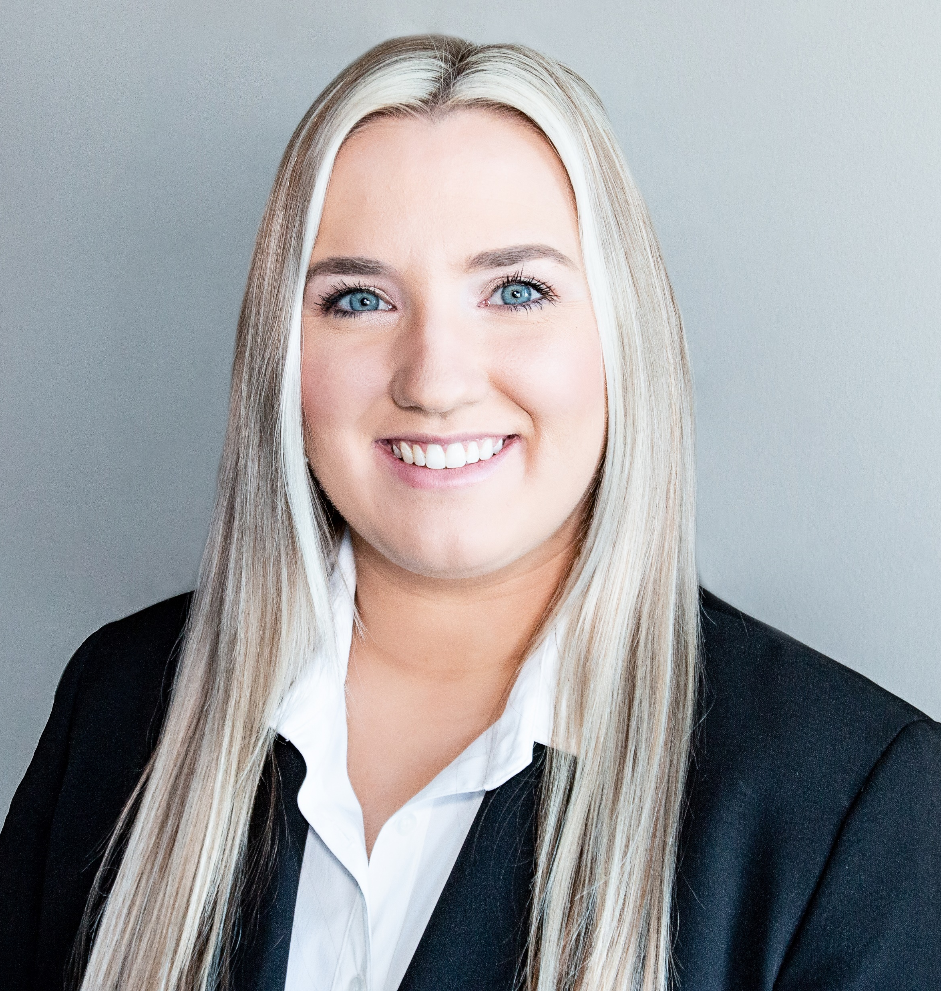
Thank you!
For questions or additional information please contact:
Debbie Boyle
Vice President
Debbie.Boyle@Kynetec.com
Courtney Wight
Senior Research Analyst
Courtney.Wight@Kynetec.com

Slide 19
Addendum

Slide 20
Radio Information: Reasons to Gather through Radio
In their own words...
AG MARKETS & COMMODITY PRICES | AG WEATHER | FARM COMMENTARY | LOCAL/REGIONAL AG NEWS | WORLD AG/TRADE NEWS | NEW AG PRODUCTS / AG INNOVATION
I get real-time updates on market trends no matter my location. Many Ag programs focus on regional markets providing me ample information tailored to my needs. | To understand the current weather situations and have accurate information about my farm. | I have been able to keep up to speed with Ag innovations, new products and new Ag techs by listening to Farm commentary. It is every farmers go-to for quick updates. | During certain times of the year, I spend a lot of time in the truck taking seeds to the seed lab. I like to hear what’s going on locally. | These shows are often hosted or reviewed by industry experts and are able to provide listeners with in-depth analysis and insights. | I want to find out what is happening with new products in our local area.
For timely update about current prices of commodities. No Internet needed, easy and cheap way to get information. | Weather plays a crucial role on commodity production. The radio provides immediate live weather reports, which include forecasts, warnings, and changes that could impact crops and livestock. | When operating large farm equipment listening to the radio is the most efficient way. | I also get some vital local news like disease breakout or a new pest. And some other news that is meant for my locality. | Easier to get the information than to search for everything myself. | I like being the first to use new products. New innovation and product can improve yield and farming process, this is why I need to stay updated on new practices, equipment and innovation.
I get update on prices of products from the radio. Both prices if inputs and products are all available and it helps in my decision making. | You can listen while driving and don't have to read or watch anything just listen. | Hearing other farmers opinions on a topic is very important. This always helps me to be more open-minded and learn from other farmers. | It provides specific information relevant to my area, including updates on local regulations, market conditions, and community events that directly impact my farming operation. | I like having information I need to know that might affect cattle and grain prices, I like to keep up with what's going on in the world. | I don’t always have time to read or explore for new products, so this allows me to stay up-to-date on new products.

