Slide 1

Farm Radio Connects
Research Conducted by Millennium Research

Slide 2
Listening With A Purpose
Farmers and ranchers are information seekers
  Farming is their livelihood and passion
  Utilize multiple media platforms
Content is focused on production ag
Delivers timely news and information
Local, regional, national news that impacts daily operation decisions
Personal connection to broadcaster and station
Knows time of ag programming, and the station call letters

Slide 3
The Audience Is Listening
Wave 1-4 Research

Slide 4
Methodology
300 sample size per quarter, total of 1200 survey completes by end of 2015
Wave 1 = Feb/March
Wave 2 = May/June
Wave 3 = September/October
Wave 4 = December
Sample size focused within 75 mile radius of station airing content produced by NAFB member
$100,000 plus Gross Farm Income (GFI) operations
Nationwide survey, calls per state based on percentage of state GFI operations, 2012 USDA Census Data

Slide 5
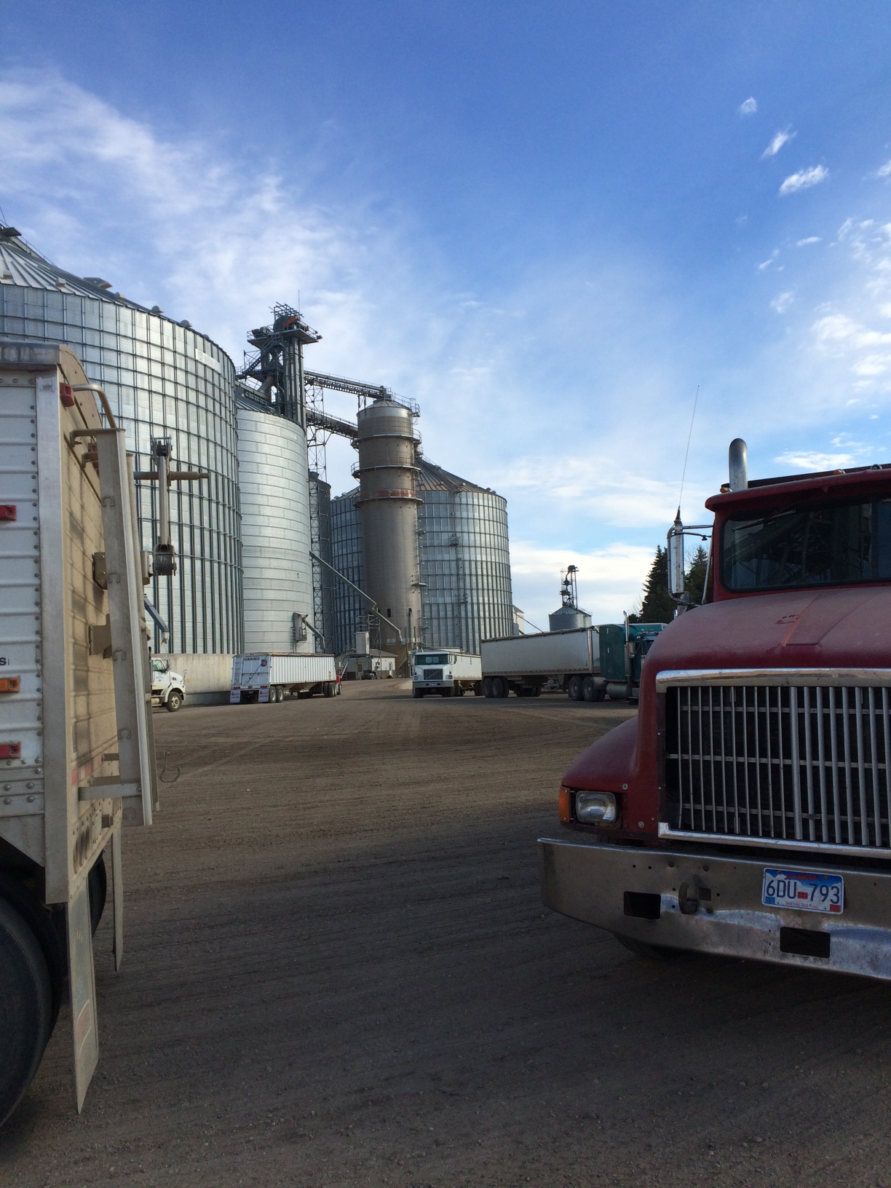
Farm Radio Listenership
Wave Comparison
Consistently, from season to season, farm radio is a leading source of farm news, information, markets and weather.
We sometimes forget how much time farmers spend waiting in their vehicle. Here is a man listening to farm radio while he waits in line at the elevator. Notice the number of trucks behind him and he’s not at the front of the line yet.

Slide 6
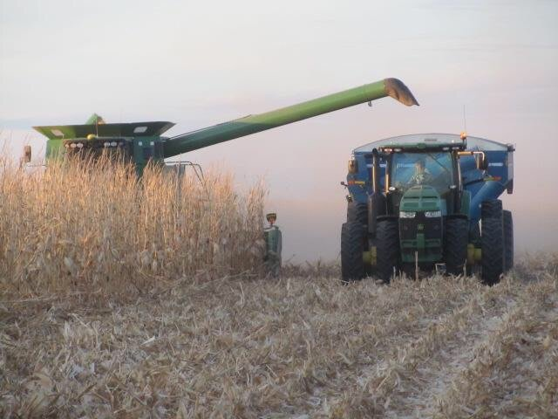
Regardless of where they are or what they are doing, farmers tune in for the weather and the markets.

Slide 7
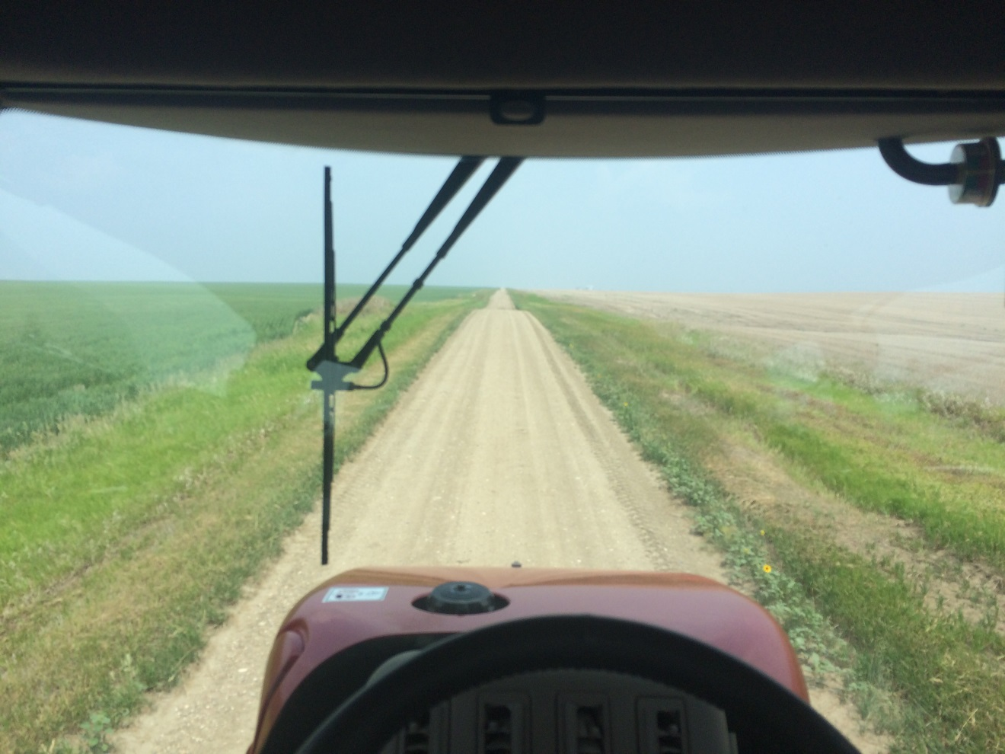
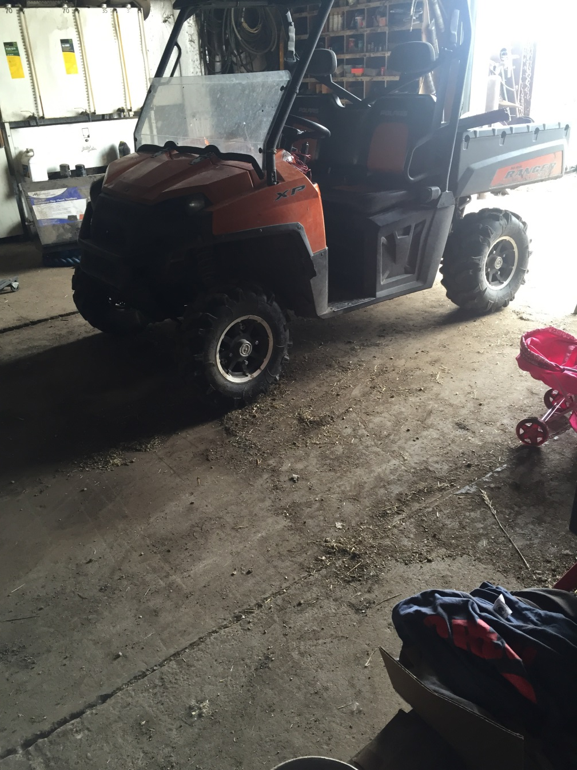
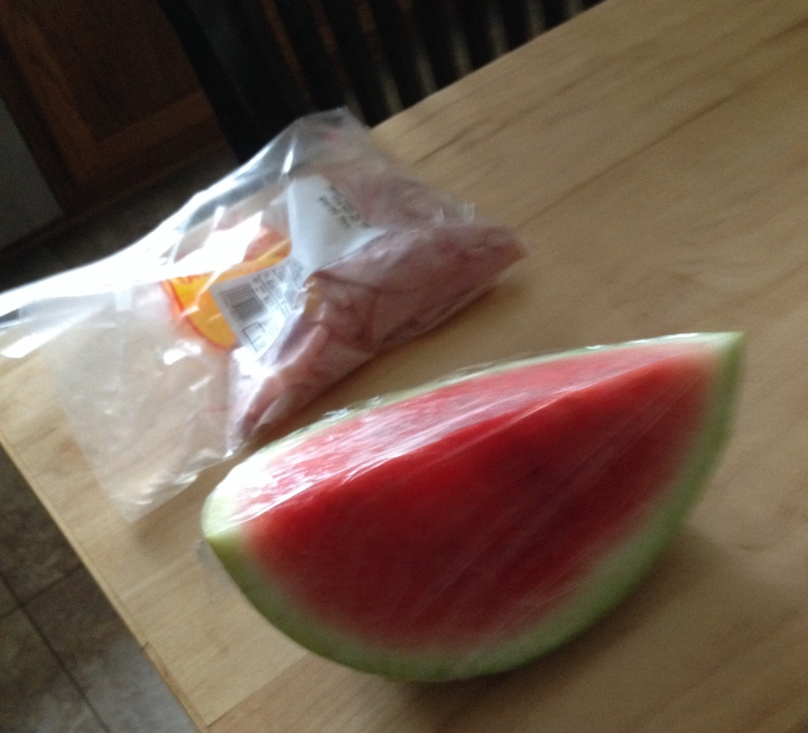

Spraying fallow weed control, going back to the water truck to fill again.
Working in shop.
Farm radio is part of everyday life on a farm operation.
I was eating a slice of watermelon and making a ham sandwich while listening to the radio.
Listen all day while in the office working.

Slide 8
76% Of Farmers Listen To Farm Radio
Percent of
respondents

Slide 9
Consistent Radio Listening Habits All Year – Farm Radio Is A Habit
Percent of
respondents

Slide 10
Daily Listenership Is Consistent All Year - 71% Listen 3+ Days Per Week
Percent of
respondents

Slide 11
Farmers Connect With Radio Daily
64% up to 60 minutes/day
35% 60+ minutes per day
Percent of
respondents

Slide 12
Farmers Are Regular Listeners

Slide 13
Frequent Listeners, Listen Longer
Minutes
per day

Slide 14
Younger Farmers Listen More Every Day Than Older Farmers
Minutes
per day

Slide 15
74% of Farmers 49 and Under Listen To Farm Radio
Percent of
respondents

Slide 16
Radio Delivers Throughout The Day
No Matter The Location
Percent of
respondents

Slide 17
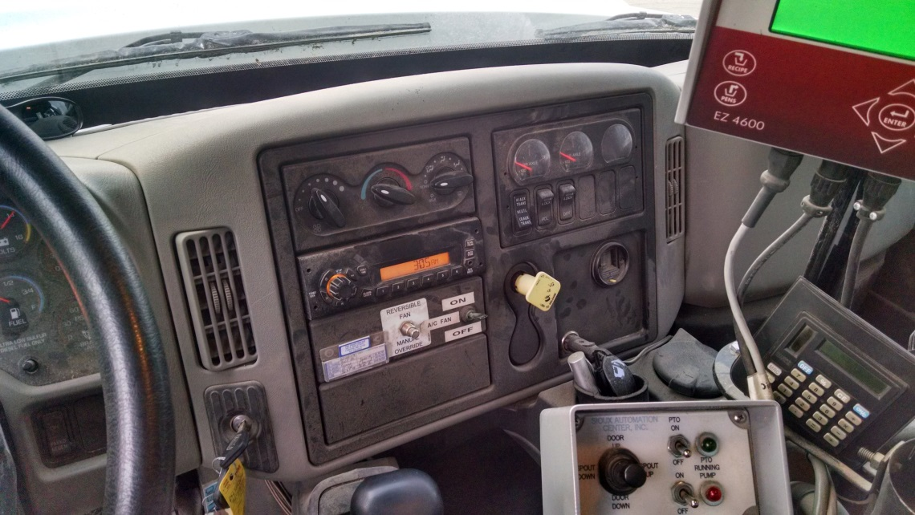
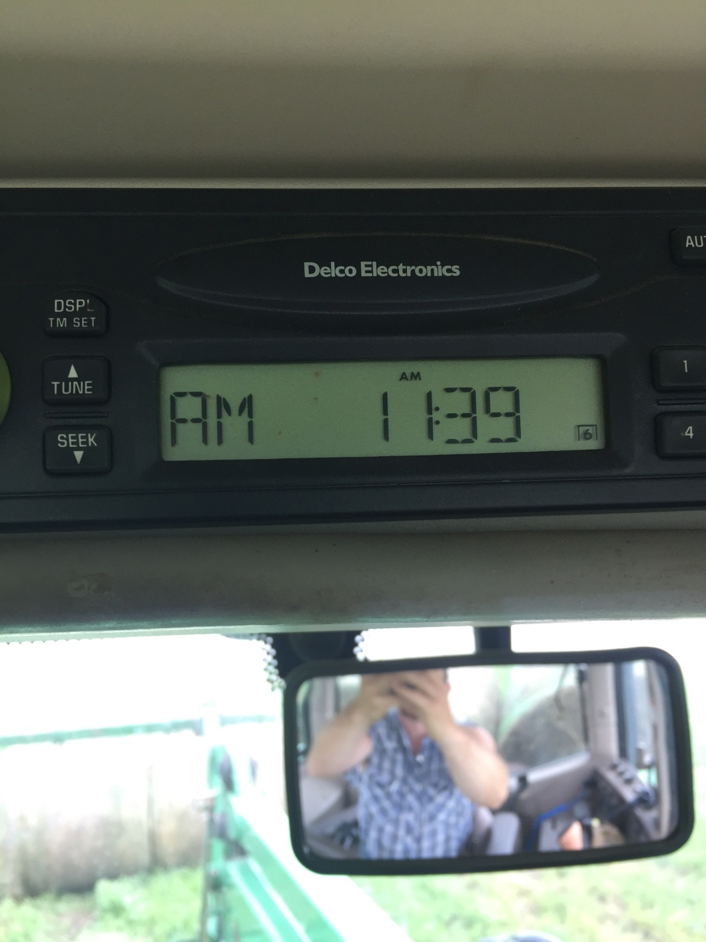
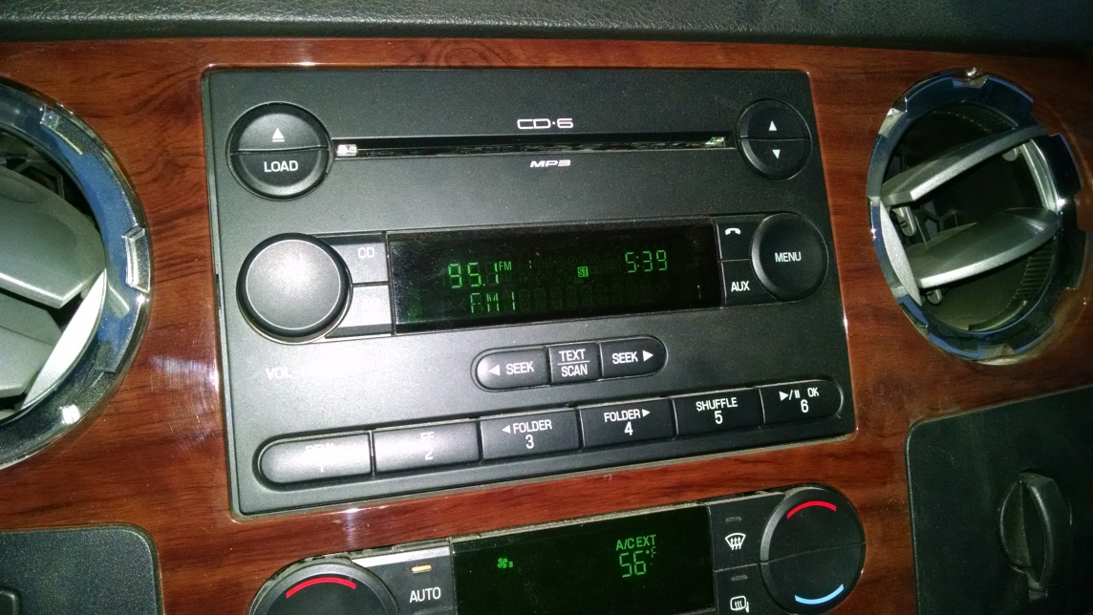
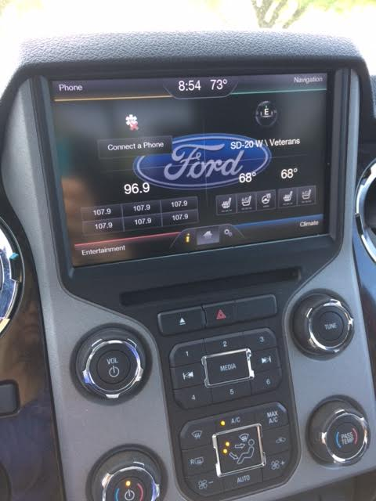
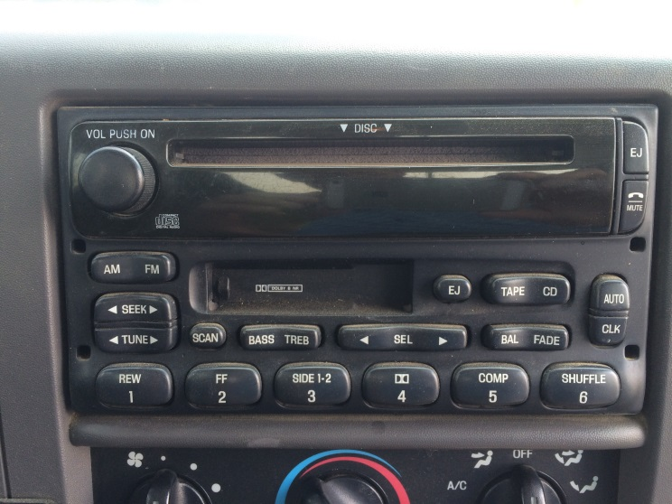
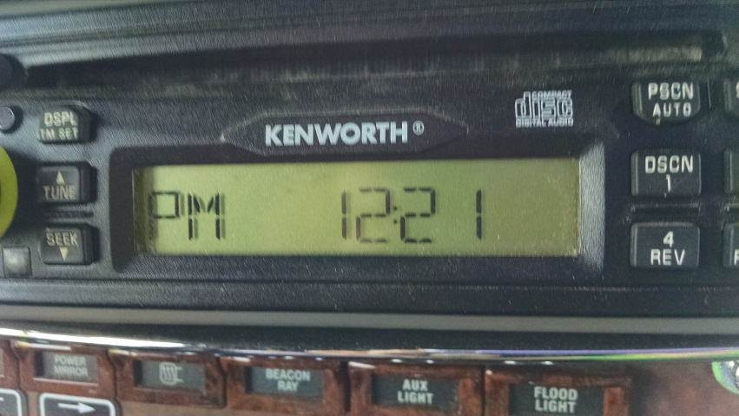
Radio is mobile. It goes with the farmer all day long.

Slide 18
Comparison of Radio Listening Locations By Age
Percent of
respondents

Slide 19
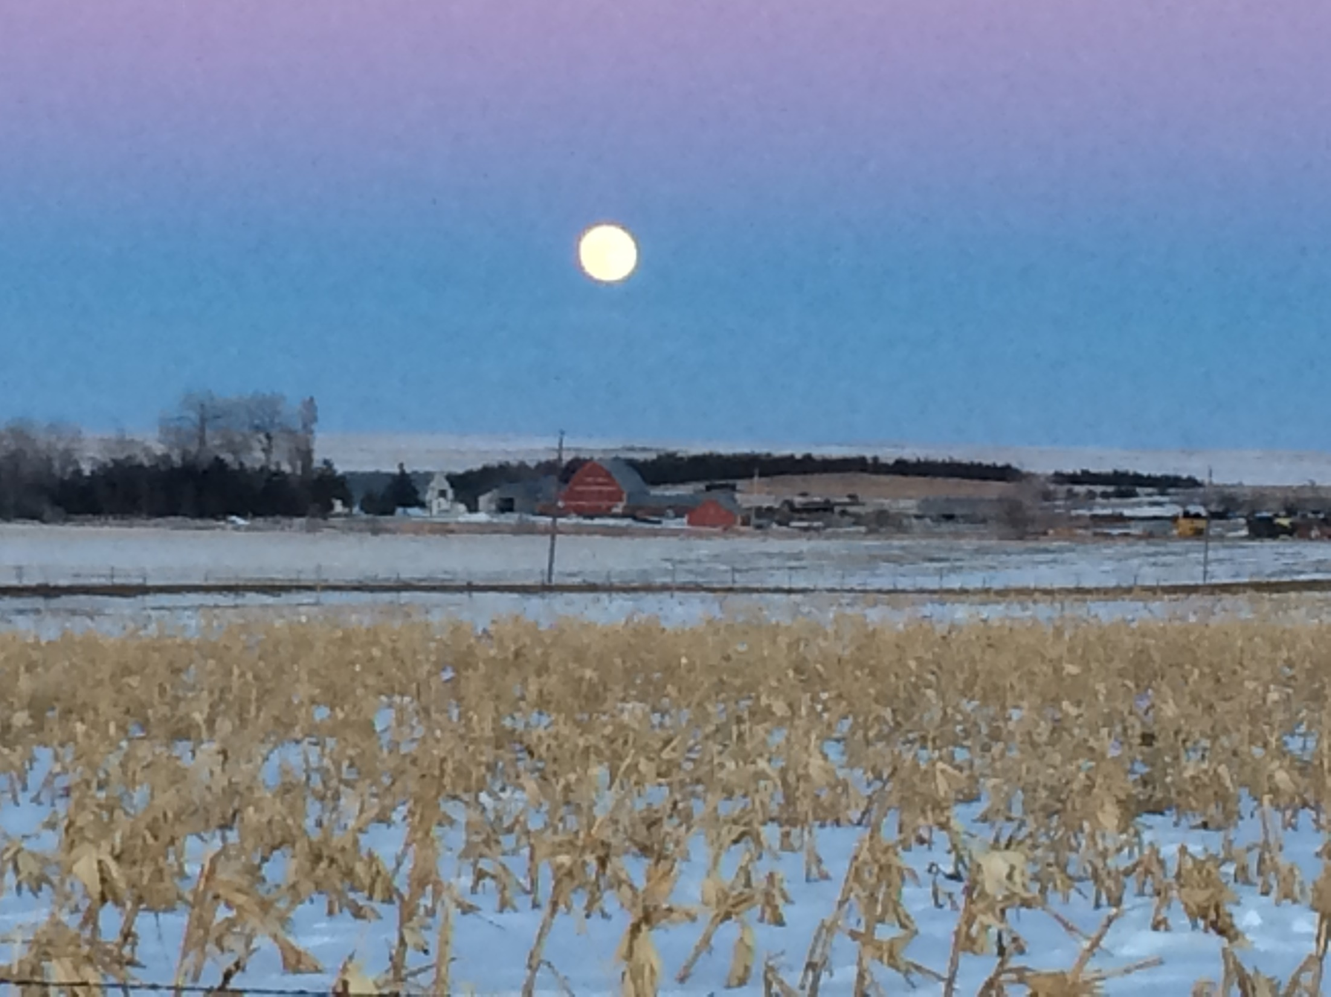
Radio is there all the time.

Slide 20
Farm Broadcasters Deliver Programming Beyond The Radio
Percent of
respondents

Slide 21
Farm Broadcasters Continue To Connect with Younger Producers
Percent of
respondents

Slide 22
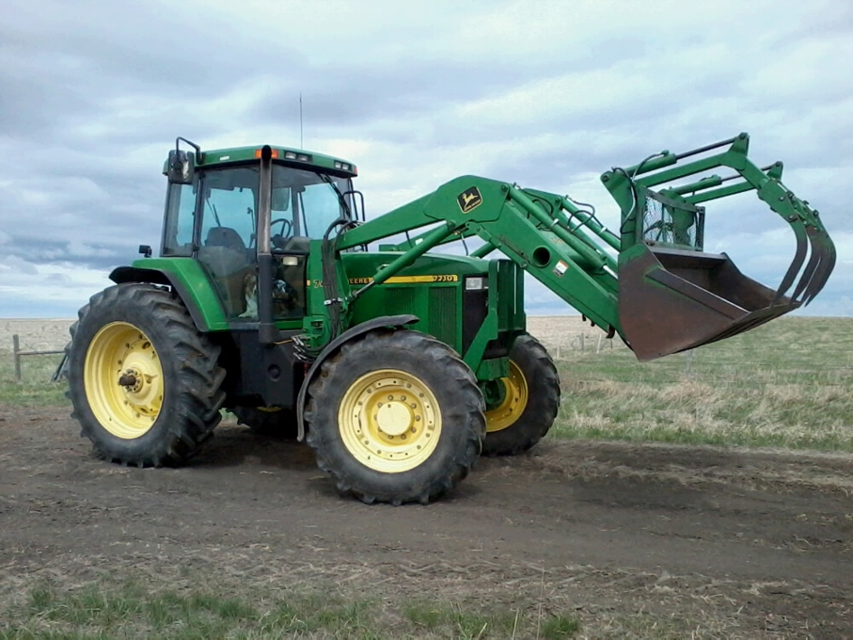


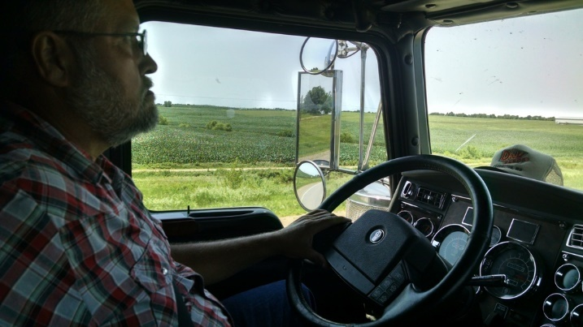
Farm Radio Listening Behavior
Farmers and farm partners can do so much while listening to farm radio. Late winter, farmers listen to radio while hauling grain to the elevator, grabbing lunch, feeding cattle, driving to an industry event. Where they listen changes as the calendar changes, but radio habits stay consistent. Radio goes where they go.

Slide 23
Saturday Programming Reaches Farmers
Percent of
respondents

Slide 24
Saturday Listenership Is Strong
Percent of
respondents

Slide 25
Key Learnings On Saturday
Saturday listeners listen on average 27.5 minutes per day Monday- Friday, and also listen on Saturday.
Saturday minutes are strong.
Heavy weekday listeners, listen the same amount of time on Saturday.
On average, farmers who listen on weekends, and weekdays tend to listen 81 percent as much on Saturday as they do during the week.

Slide 26
Saturday Sports Listening By Waves
Percent of
respondents

Slide 27
Saturday Sports Listenership Is Popular Among Both Young And Older Farmers
Percent of
respondents

Slide 28
60% Of Farmers Watch TV Ag
Percent of
respondents

Slide 29
Farmers Of All Ages Watch Ag TV
Percent of
respondents

Slide 30
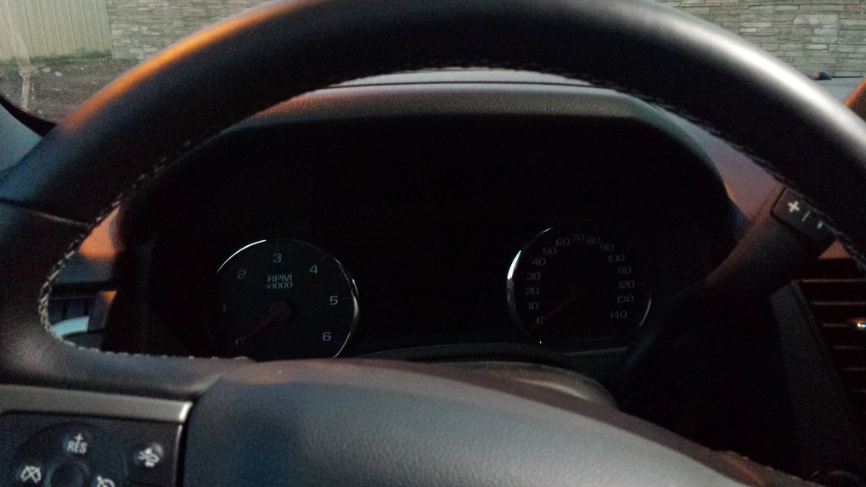
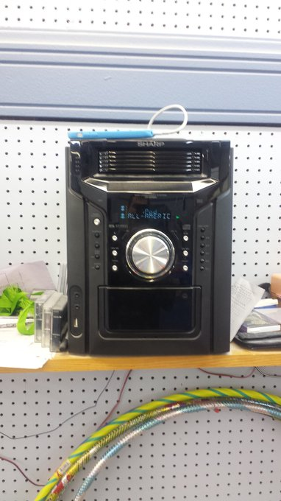
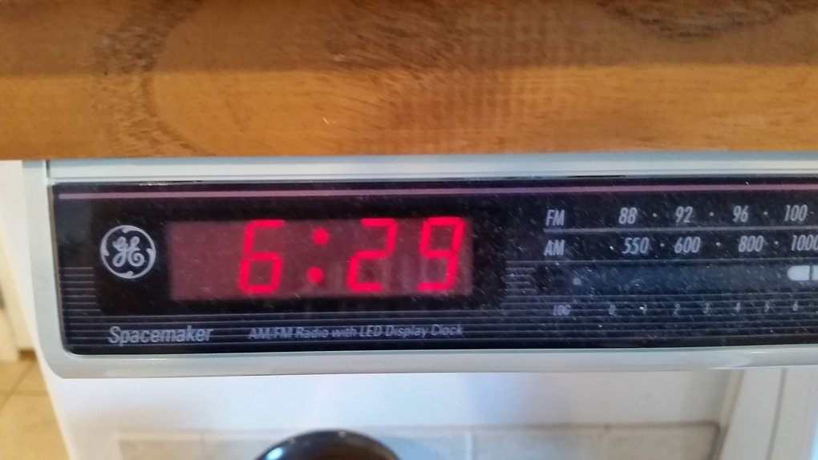
Radio Band Listenership

Slide 31
More Listeners Listen To Farm Radio On Multiple Bands
N=301
Wave 1 did not specify farm news, weather and markets.

Slide 32
Radio Reaches Farmers and Ranchers
Percent of
respondents
Wave 1 Wave 2 Wave 3 Wave 4
Wave 1 did not specify farm news, weather and markets.

Slide 33
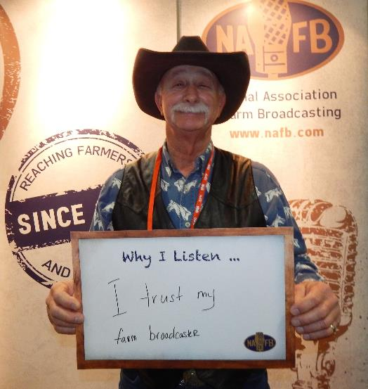
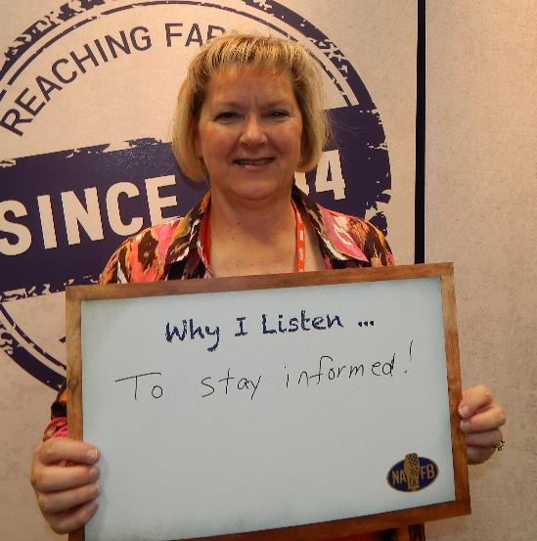
How Are Farm Broadcaster
Regarded By Their Listeners
Farm broadcasters are considered very credible, trustworthy and accurate by a vast majority of listeners.

Slide 34
Frequent Listeners Rate Their Broadcaster Higher Than Those Who Listen Less Often
Average
rating

Slide 35
Broadcaster Accuracy Is Rated Consistently High Regardless Of Farm Revenue
Average
rating

Slide 36
Frequent Listeners Rate Their Broadcast Higher on Credibility
Average
rating

Slide 37
Farmers Consistently Rate Farm Broadcaster High On Credibility
Average
rating

Slide 38
More Frequent Listeners Rate Their Broadcaster Higher On Timely Information
Average
rating

Slide 39
Listeners Rate Their Broadcasters On Providing Timely Information
Average
rating

Slide 40
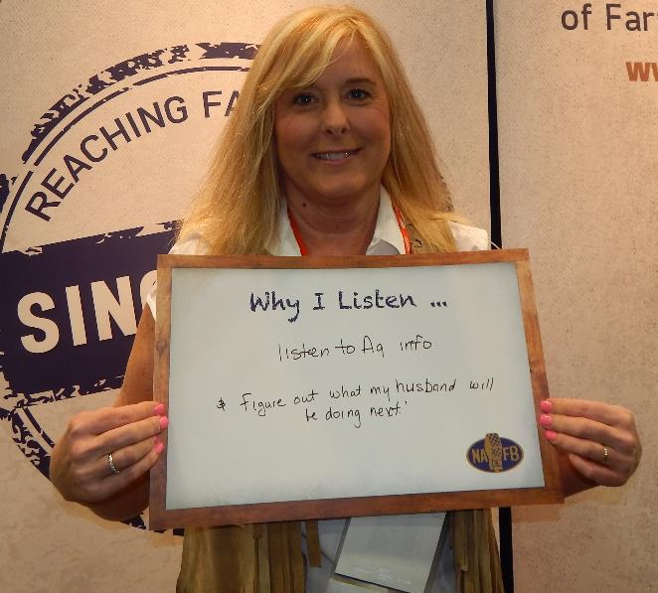
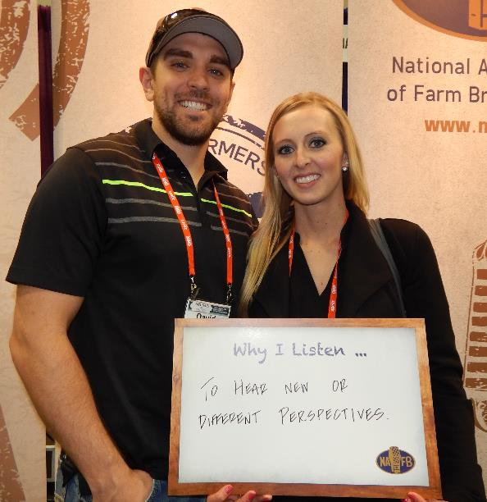
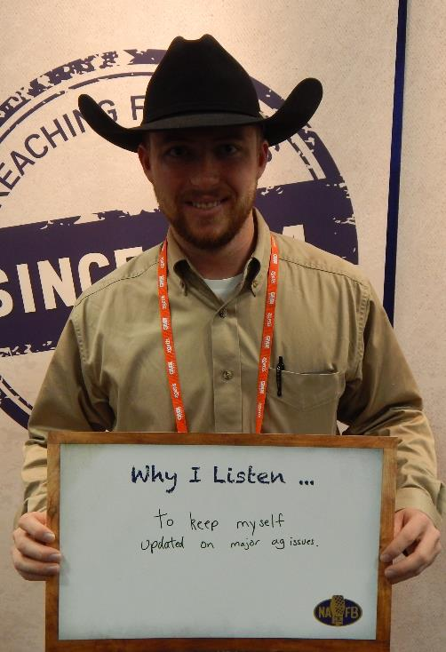
Respondent Demos

Slide 41
Gross Farm Revenue By Data Collection Wave
Number of
respondents

Slide 42
On Average, Respondents Farm Almost 1,900 Acres
Average
Number of
Acres

Slide 43
Younger Growers Tend To Control More Acres
Average
Number of
Acres

Slide 44
Corn Is The Most Frequently Planted Crop By Respondents
Percent of
respondents

Slide 45
Half Of Respondents Have Livestock Or Dairy Operations
Percent of
respondents

Slide 46
9 Out Of 10 Farmers Surveyed Are Decision Makers
Percent of
respondents

Slide 47

Thank You.
This information is property of the National Association of Farm Broadcasting. Written permission to reproduce and use is required. Please contact the NAFB office, 816.431.4032. NAFB.com
© 2016 National Association of Farm Broadcasting

